Slide 1
Mechanisms of Evolution

Slide 2
Mechanisms of Change
Mutation
Migration
Genetic drift
  Founder effect
  Bottleneck
Natural selection

Slide 3
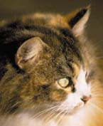
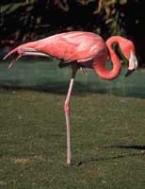
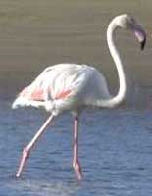
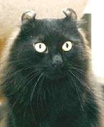
Genotype vs. Phenotype
In defining evolution we are concerned with genotypes that make up a population from generation to generation

Slide 4

Genetic Variation
Evolution does not operate without variation being present in population
primary sources of genetic variation
  Mutations
  Gene flow
  Sexual reproduction
Notes:
Mutations are random.
mutations can be beneficial, neutral, or harmful for the organism
mutations do not “try” to supply what the organism “needs.”
In this respect, mutations are random
whether a particular mutation happens or not is unrelated to how useful that mutation would be
Only mutations that matter to large scale evolution are those that can be passed to offspring
Germ line mutations—mutations in egg or sperm

Slide 5
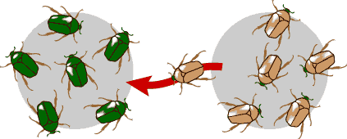
Gene Flow
Movement of genes from one population to another
Migration
Examples
  Pollen being blown to new destination
  People moving to new cities or countries
  Important source of genetic variation

Slide 6
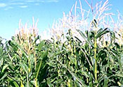
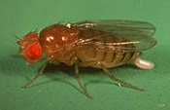
Gene Flow
Amount depends on organism
  Sedentary organisms more isolated than mobile ones
Example
  Lower rate of gene flow
    Corn—wind pollinated
    Unlikely to fertilize individuals more than 50 ft away
  Higher rate of gene flow
    Fruit flies
    Released in death valley and recaptured 15 km away
Effects on evolution
  Within a population
    Introduce or reintroduce genes to a population
    Increases genetic variation
  Across populations
    Makes distant populations genetically more similar
    Reducing chances of speciation
Less gene flow between two populations, speciation more likely to occur

Slide 7
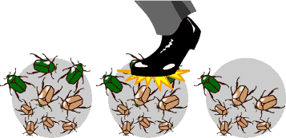
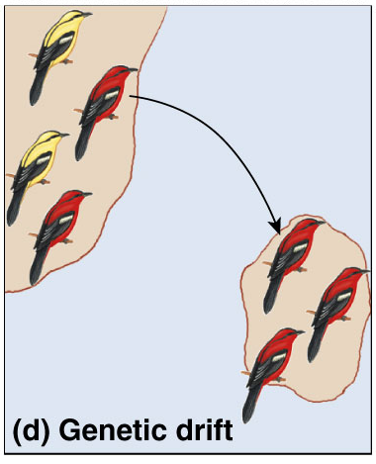
Genetic Drift
Chance events changing frequency of traits in a population
  not adaptation to environmental conditions
    not selection
  founder effect
    small group splinters off & starts a new colony
  bottleneck
    some factor (disaster) reduces
    population to small number & then
    population recovers & expands
    again but from a limited gene pool

Slide 8
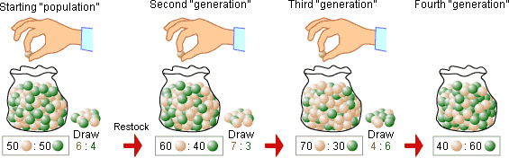
Genetic Drift—Sampling Errors
Genetic drift is evolutionary equivalent of sampling error
Example
  ratio of brown to green marbles “drifts” around
  5:5, 6:4, 7:3, 4:6 . . .

Slide 9
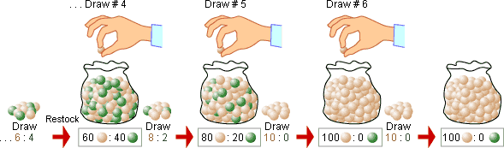
Effects of Genetic Drift on Evolution
Reduces genetic variation in populations
  potentially reducing population’s ability to evolve in response to new selective pressures.

Slide 10
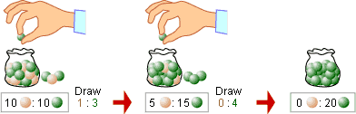
Effects of Genetic Drift on Evolution
Acts faster and has more drastic results in smaller populations
  particularly important in rare & endangered species.

Slide 11
Effects of Genetic Drift on Evolution
Can contribute to speciation
  small isolated population may diverge from the larger population through genetic drift.

Slide 12
Types of Genetic Drift
Bottleneck event
Founder effect

Slide 13
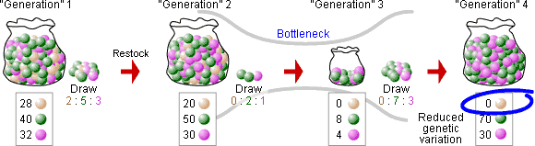
Genetic Drift—Bottlenecks
Population bottlenecks
  occur when a population’s size is reduced for at least one generation
  genetic drift acts more quickly to reduce genetic variation in small populations

Slide 14
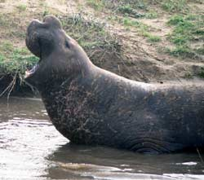
Example of Bottleneck Effect
  Northern elephant seals
    Reduced genetic variation
    Population bottleneck in 1890s due to overhunting
    Population size reduced to around 20 individuals
    now over 30,000
    Very little variation left in this population

Slide 15
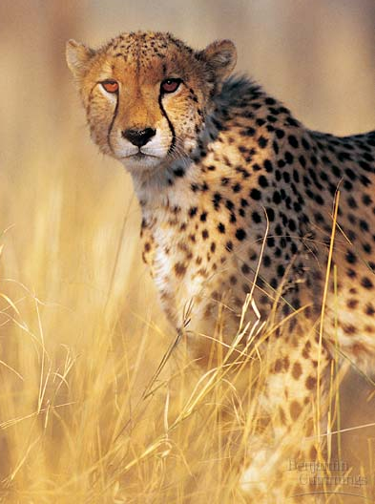
Cheetahs
All cheetahs share a small number of alleles
  less than 1% genetic variation
  as if all cheetahs are
  identical twins
2 bottlenecks
  10,000 years ago
    Ice Age
  last 100 years
    poaching & loss of habitat

Slide 16
Founder effect
When a new population is started
by only a small group of individuals
  just by chance some rare alleles may
  be at high frequency; others may be missing
  Usually reduced genetic variation
  skew the gene pool of new population
    human populations that started from small group of colonists
    example:
    colonization of New World

Slide 17
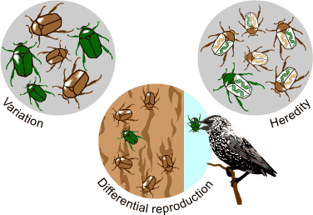
Natural Selection
Differential reproductive success
Selection acts on any trait that affects survival or reproduction
  predation selection
  physiological selection
  sexual selection

Slide 18
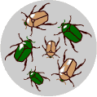
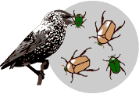
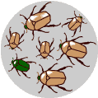
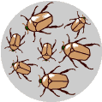
Comparing Forces of evolutionary change
Natural selection
  traits that improve survival
  or reproduction will accumulate
  in the population
    adaptive change
Genetic drift
  frequency of traits can change
  in a population due to
  chance events
    random change

Slide 19
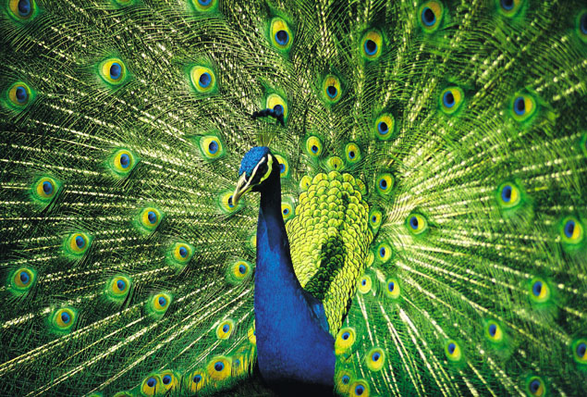
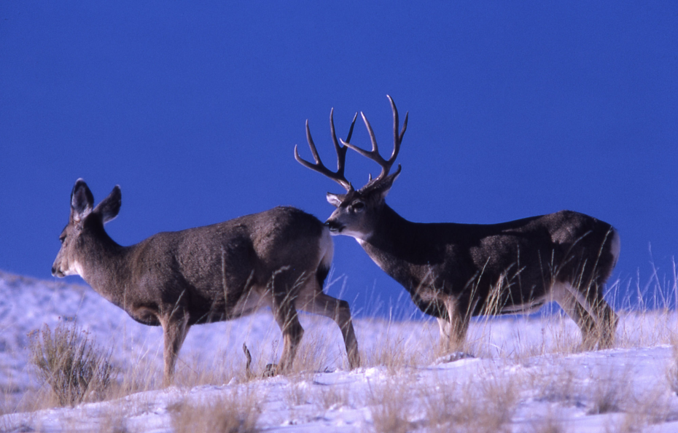
Sexual Selection
Acting on reproductive success
  attractiveness to potential mate
  fertility of gametes
  successful rearing of offspring
Survival doesn’t matter
if you don’t reproduce!

Slide 20
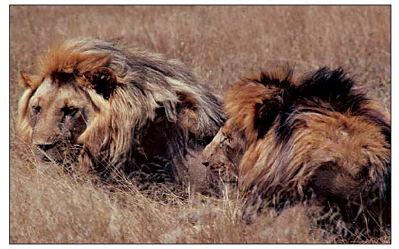
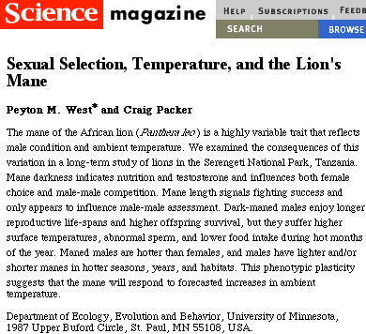
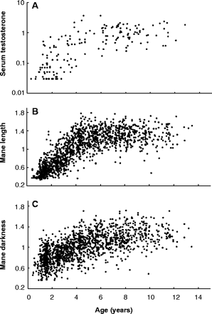
The lion’s mane…
Females are attracted to males with larger, dark manes
Correlation with higher testosterone levels
  better nutrition & health
  more muscle & aggression
  better sperm count / fertility
  longer life
But imposes a cost to male
  HOT! Is it worth it??

Slide 21
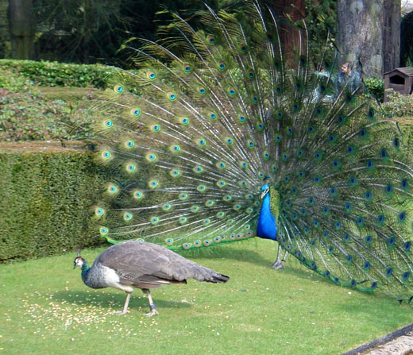
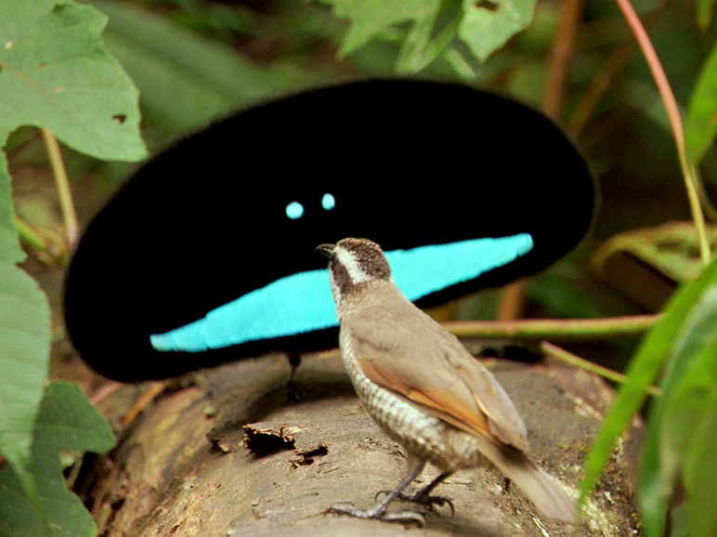
Sexual selection
Acts in all sexually
reproducing species
  traits that get you mates
    sexual dimorphism
  influences both morphology & behavior
  can act in opposition to natural selection

Slide 22
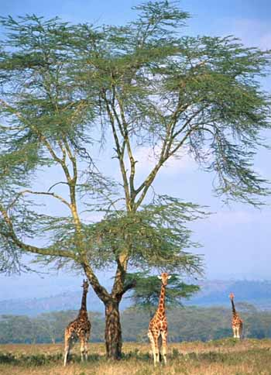
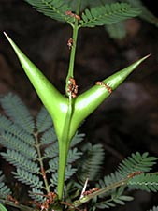
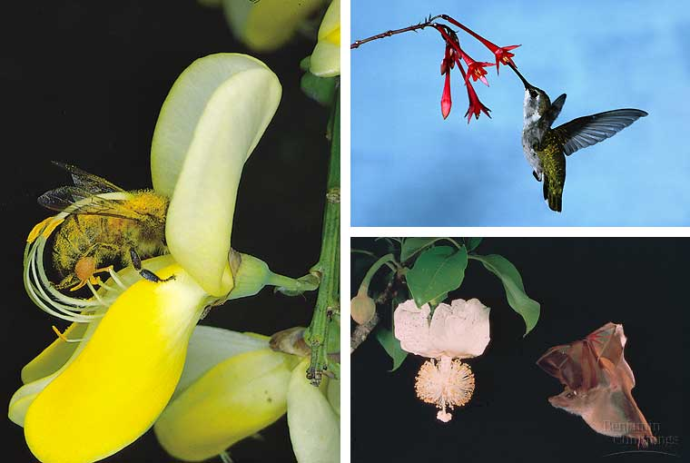
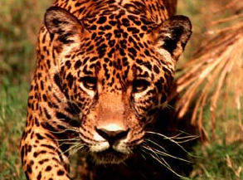
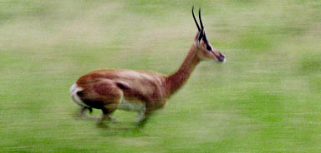
Coevolution
Two or more species reciprocally
affect each other’s evolution
  predator-prey
    disease & host
  competitive species
  mutualism
    pollinators & flowers

Slide 23
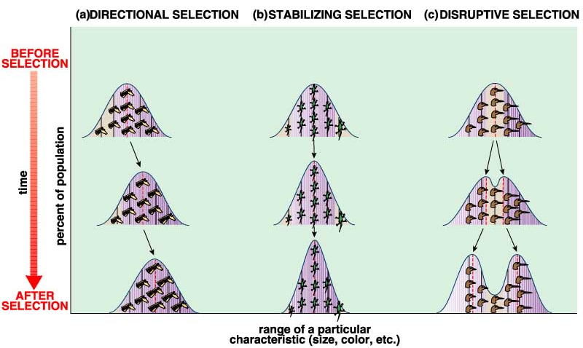
Effects of Selection
Changes in the average trait of a population
DIRECTIONAL
SELECTION
STABILIZING
SELECTION
DISRUPTIVE
SELECTION
giraffe neck
horse size
human birth weight
rock pocket mice

Slide 24
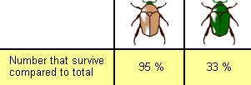
Fitness
Describes how good a particular genotype is at leaving offspring in the next generation relative to how good other genotypes are at it
Example:
  If brown beetles consistently leave more offspring than green beetles because of their color, you’d say that the brown beetles had a higher fitness

Slide 25
Fitness
Fitness is relative
  A genotype may be very fit in one environment and not fit at all in another
Fitness lumps everything that matters to natural selection into one idea
  Survival
  Mate finding
  Reproduction
Fittest individuals not always strongest, fastest or biggest
Fitness of a genotype depends on
  Ability to survive
  Find a mate
  Produce successful offspring

Slide 26
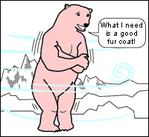
Misconceptions about Natural Selection
Does not produce perfection
  No population or organism is perfectly adapted
Natural selection has no goals
  Natural selection is the simple result of variation, differential reproduction and heredity
“need”, “try” and “want”
are not very accurate
words when it comes
to explaining evolution
Natural selection selects
whatever variations exit in
the population—results in
evolution

Slide 27
Misconceptions about Natural Selection
Sometimes interpreted as a random process
Genetic variation in a population is random
Selection that acts on the variation is
non-random
  Genetic variation that aids survival and reproduction are more likely to become common that other variation
  Natural selection is not random!

Slide 28
Misconceptions about Natural Selection
Natural selection acts on individuals
  Differential survival
    Survival of the fittest
  Differential reproductive success
    Bear more offspring
Populations evolve
  Populations of organisms change over time
  Traits which offer greater fitness become more frequent in the population

