Slide 1
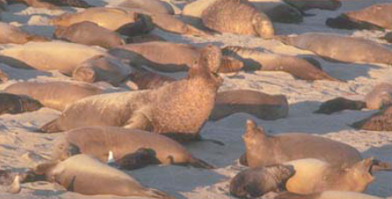
Population Genetics—provides framework for studying evolution
“I’m from the shallow end of the gene pool!”

Slide 2
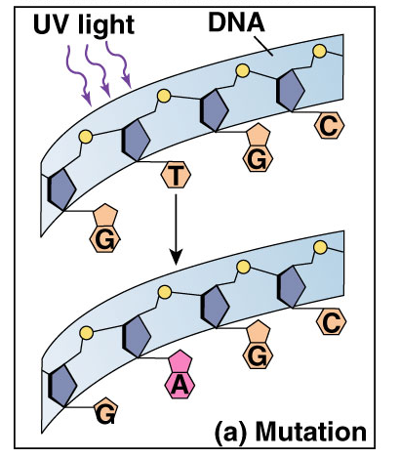
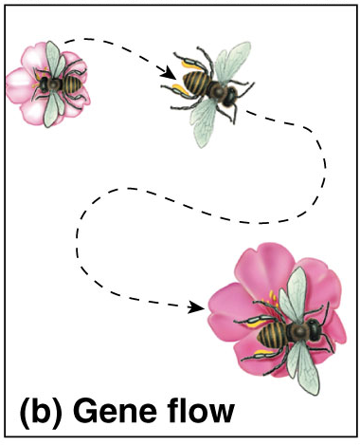
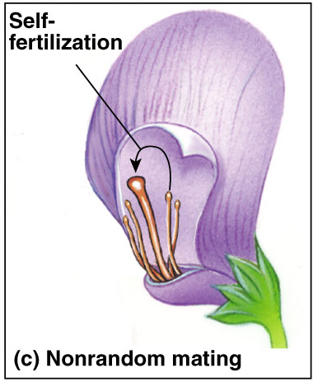
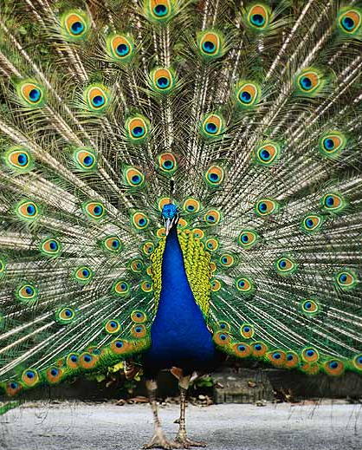
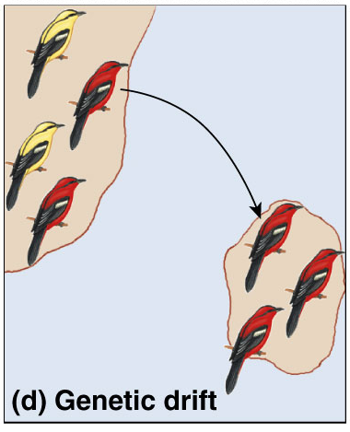
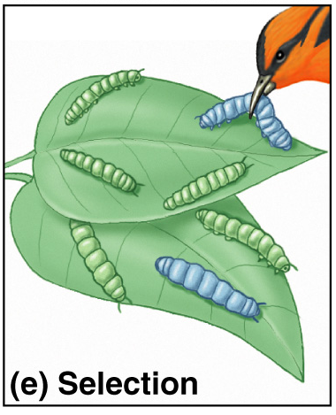
5 Agents of evolutionary change
Mutation
Gene Flow
Non-random mating
Genetic Drift
Selection

Slide 3
Smallest unit that can evolve….
Individuals are selected for or against…
Only populations evolve

Slide 4
Populations and gene pools
A population is a localized group of interbreeding individuals
Gene pool is collection of all alleles at all loci in all individuals in the population
Allele frequency is frequency of allele in a population
  Number of “A” alleles vs. number of “a” alleles

Slide 5
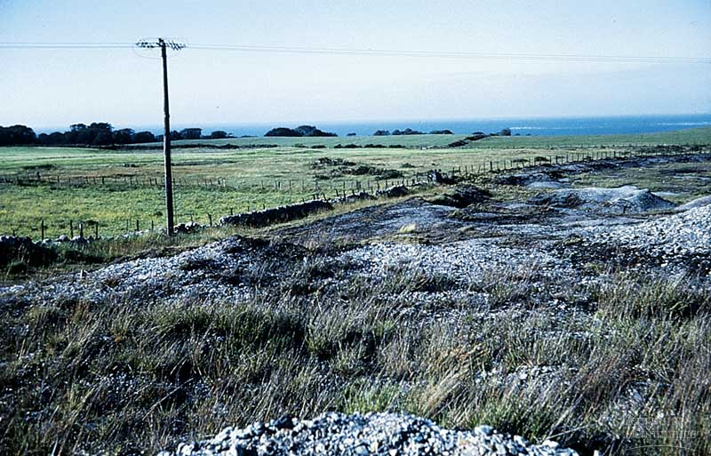
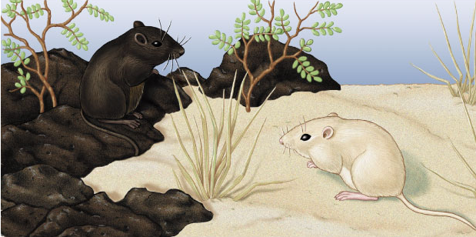
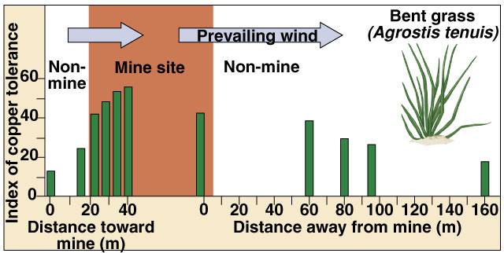
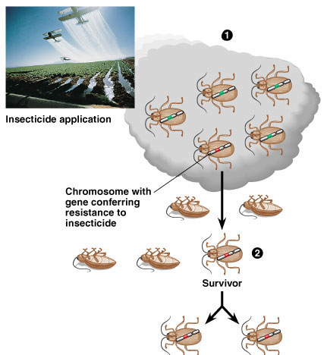
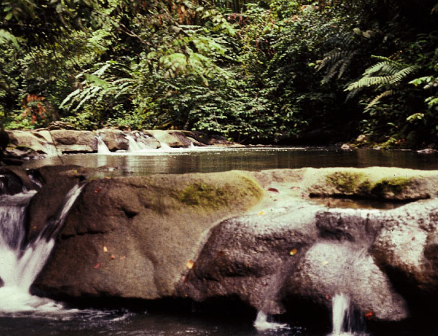
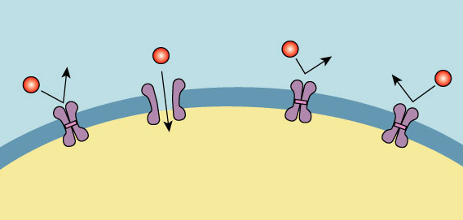
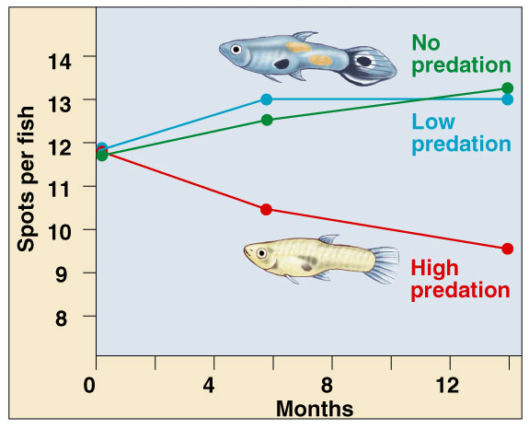
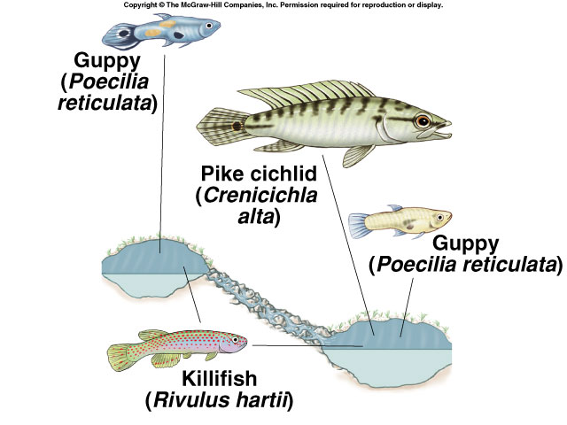
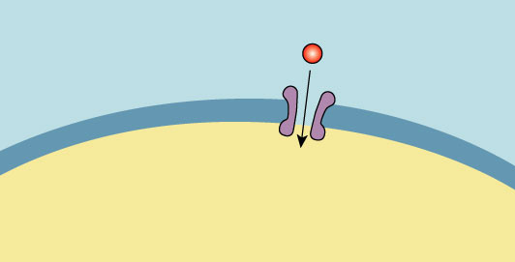
Changes in populations
Bent Grass on toxic mine site
Pocket Mice in desert lava flows
Pesticide
molecule
Target site
Resistant
target site
Insect cell
membrane
Target site
Insecticide resistance
Decreased number of target sites

Slide 6
Changes in Gene Pools
Processes that lead to genetic variation are random
  Mutations
  Meiosis
  Sexual Reproduction
Natural selection is NOT random
Environment favors genetic combinations that contribute to survival and reproductive success
  Alleles may become more common than other alleles in the gene pool
  There is a change in the frequency of alleles
    how often an allele occurs in a population
    a generation to generation change in the frequencies of alleles within a population

Slide 7
If a population is NOT evolving…
Evolution implies a change in allele frequencies in a population
Population is not undergoing a change in their gene pool
Condition is called Hardy Weinberg Equilibrium
Assumptions for Hardy Weinberg Equilibrium Hypothetical Non-evolving population
  Very large population (no genetic drift)
  No migration (in or out)
  No mutation
  Random mating (no competition)
  No natural selection
  Autosomal traits
  Diploid, sexually reproducing population

Slide 8
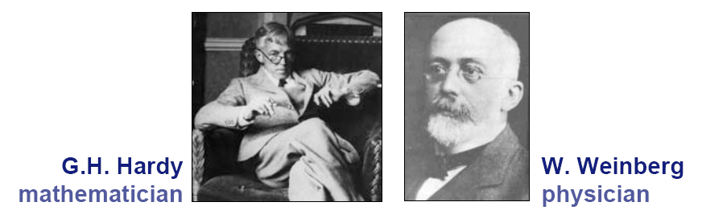
Hardy-Weinberg Equilibrium
Hypothetical, non-evolving population
  Preserves allele frequencies
Serves as a model
  Natural populations rarely in HW equilibrium
  Useful model to measure if forces are acting on a population to cause change

Slide 9
Hardy Weinberg Theorum
p² + 2pq + q² = 1
p
  frequency of dominant allele in population (A)
q
  frequency of recessive allele in population (a)
p + q = 1
p² + 2pq + q² = 1
AA + Aa + aa = 1

Slide 10
Hardy Weinberg Theorum
p² + 2pq + q² = 1
p
  frequency of dominant allele in population (A)
q
  frequency of recessive allele in population (a)
p + q = 1
p² + 2pq + q² = 1
AA + Aa + aa = 1
 | A (p) | a (q)
A (p) | AA (p²) | Aa (pq)
a (q) | Aa (pq) | Aa (q²)

Slide 11
Calculating frequency of alleles
Wildflower population with 2 flower colors
Allele for red flower color (R) is completely dominant to the allele for white flowers (r)
Population of 500 plants
What is the allele frequency?

Slide 12
Calculating frequency of alleles
R
RR: 320 x 2 = 640
Rr: 160 x 1 = 160
R: 800/1000 = 80%
p=0.8
r
Rr: 20 x 2 = 40
Rr: 160 x 1 = 160
R = 200/1000 = 20%
q=0.2

Slide 13
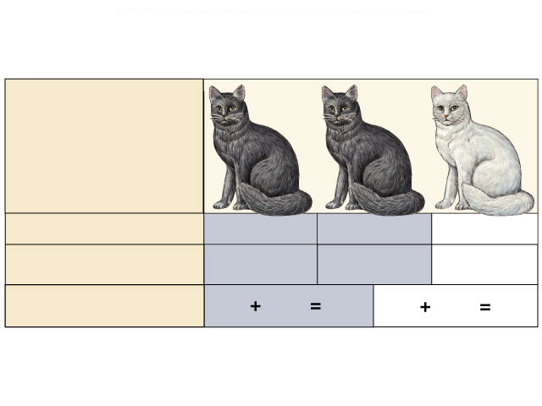
Hardy-Weinberg theorem
Counting Alleles
  assume 2 alleles = B, b
  frequency of dominant allele (B) = p
  frequency of recessive allele (b) = q
    frequencies must add to 1 (100%), so:
  p + q = 1
BB
Bb
bb

Slide 14
Hardy-Weinberg theorem
Counting Individuals
  frequency of homozygous dominant: p x p = p²
  frequency of homozygous recessive: q x q = q²
  frequency of heterozygotes: (p x q) + (q x p) = 2pq
    frequencies of all individuals must add to 1 (100%), so:
  p² + 2pq + q² = 1
BB
Bb
bb

Slide 15
H-W formulas
Alleles: p + q = 1
Individuals: p² + 2pq + q² = 1
B
b
BB
Bb
bb
BB
Bb
bb

Slide 16
Using Hardy-Weinberg equation
population:
100 cats
84 black, 16 white
How many of each genotype?
q² (bb): 16/100 = .16
q (b): √.16 = 0.4
p (B): 1 - 0.4 = 0.6
p²=.36
2pq=.48
q²=.16
BB
Bb
bb
What are the genotype frequencies?
Must assume population is in H-W equilibrium!

Slide 17
Using Hardy-Weinberg equation
p²=.36
2pq=.48
q²=.16
Assuming
H-W equilibrium
BB
Bb
bb
Null hypothesis
p²=.20
p²=.74
2pq=.64
2pq=.10
q²=.16
q²=.16
BB
Bb
bb
Sampled data
How do you explain the data?
How do you explain the data?

Slide 18
Application of HW Theorum
  What % of the human population carries allele for PKU?
    ~1 in 10,000 babies born in the US is born with PKU, which results in mental retardation and other problems if untreated
    Disease caused by a recessive allele

Slide 19
Application of HW theorum
Frequency of homozygous recessive individuals
  q² = 1 in 10,000 or 0.0001
Frequency of recessive allele (q):
q= √ q² ⁼ √0.0001 = 0.01
Frequency of dominant allele (p):
p + q = 1
p = 1 – q = 1 – 0.01 = 0.99
Frequency of carriers, heterozygotes (2pq):
2 x (0.99 x 0.01) = 0.0198 or ~ 2%
~2% of the US population carries the PKU allele

Slide 20
Implications of HW Theorem
In HW population, all alleles remain at same frequencies from generation to generation
If allele frequencies change, then population is not in equilibrium and evolution is occurring
Population biologists measure and study
  Sampling of individuals and genetic testing
  Measure from year to year

Slide 21
Blood Type in Pueblo Indians (MN system)
Indian group is isolated
Do not interbreed with other groups
Genotypes | MM | MN | NN
Observed # of individuals | 83 | 46 | 11
Genotype Frequencies

Slide 22
Blood Type in Pueblo Indians (MN system)
Indian group is isolated
Do not interbreed with other groups
Genotypes | MM | MN | NN
Observed # of individuals | 83 | 46 | 11
Genotype Frequencies | 83/140=.59 | 46/140=.32 | 11/140=.08

Slide 23
Genotype Frequencies observed:
  MM = .59
  MN = .32
  NN = .08
Calculate frequency of the M allele where M = p
  p = .59 + ½ (.32) = .75
  p = .75
Calculate frequency of the N allele where N =q
  q = ½ (.32) + .08 = .25
  q = .25

Slide 24
Calculate expected number of individuals n = total number of individuals in population
MM | MN | NN

Slide 25
Calculate expected number of individuals n = total number of individuals in population
MM | MN | NN
p2(n) | 2pq(n) | q2(n)

Slide 26
Calculate expected number of individuals n = total number of individuals in population
MM | MN | NN
p2(n) | 2pq(n) | q2(n)
(.75)2 (140) | 2(.75)(.25)(140) | (.25)2(140)
78.75 | 52.5 | 8.75

Slide 27
Do א² test to determine whether the observed values and expected values are significantly different from one another.
H_{o}
  Population is in Hardy-Weinberg equilibrium for this locus; no evolution or change is occurring in this population.
H_{a}
  Population is not in Hardy-Weinberg equilibrium for this locus; some force is causing evolution in this population
א² = Σ (o-e)²
e

Slide 28
א²
MM | MN | NN

Slide 29
א²
MM | MN | NN
(83-78.75)²/ 78.75 | (49-52.5)²/ 52.5 | (11-8.75)²/ 8.75

Slide 30
א²
MM | MN | NN
(83-78.75)²/ 78.75 | (49-52.5)²/ 52.5 | (11-8.75)²/ 8.75
.229 | .805 | .576
 |  | א² = 1.61

Slide 31
Degrees of freedom = 3
  (# categories) – 1
  categories not independent
    P was calculated from data
    if you know p then you know q
Critical value of p = .20 with 1df = about 1.70
If א² is greater than critical value then reject H_{o}
If א² is less than the critical value then accept H₀
Our א² = 1.61 therefore we accept H_{o}
Since p = .20, we would be wrong to accept the Ho less than 20% of the time
  You can artificially inflate the value of א² if one category is small (NN=11)
  Should usually use critical value at p = .05
Population is in HW equilibrium
No forces acting to change allele frequencies in this population

Slide 32
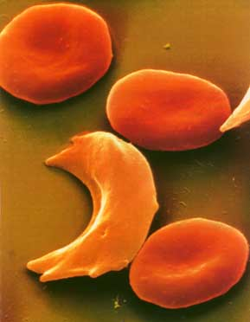
Application of H-W principle
Sickle cell anemia
  inherit a mutation in gene coding for hemoglobin
    oxygen-carrying blood protein
    recessive allele = H^{s}H^{s}
      normal allele = H^{b}
  low oxygen levels causes
  RBC to sickle
    breakdown of RBC
    clogging small blood vessels
    damage to organs
  often lethal

Slide 33
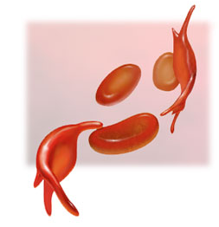
Sickle cell frequency
High frequency of heterozygotes
  1 in 5 in Central Africans = H^{b}H^{s}
  unusual for allele with severe
  detrimental effects in homozygotes
    1 in 100 = H^{s}H^{s}
    usually die before reproductive age
Why is the H^{s} allele maintained at such high levels in African populations?
Suggests some selective advantage of being heterozygous…

Slide 34
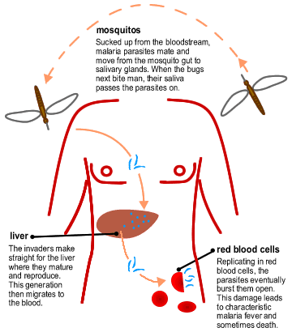
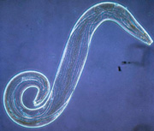
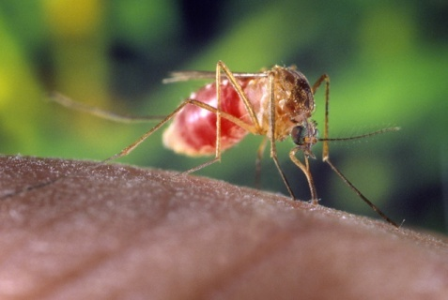
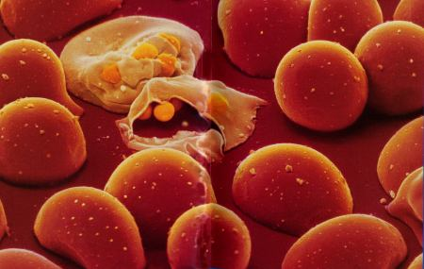
Single-celled eukaryote parasite (Plasmodium) spends part of its life cycle in red blood cells
Malaria
1
2
3

Slide 35
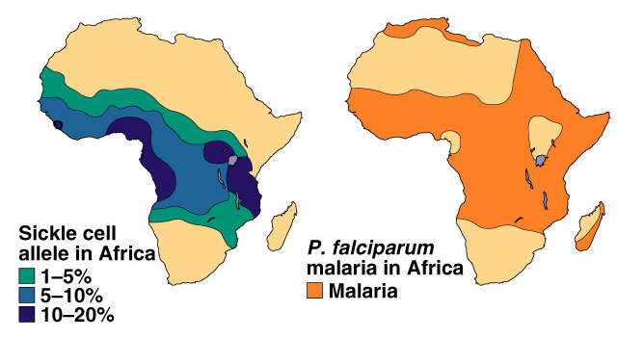
Heterozygote Advantage
In tropical Africa, where malaria is common:
  homozygous dominant (normal)
    die or reduced reproduction from malaria: H^{b}H^{b}
  homozygous recessive
    die or reduced reproduction from sickle cell anemia: H^{s}H^{s}
  heterozygote carriers are relatively free of both: H^{b}H^{s}
    survive & reproduce more, more common in population
Hypothesis:
In malaria-infected cells, the O₂ level is lowered enough to cause sickling which kills the cell & destroys the parasite.
Frequency of sickle cell allele & distribution of malaria

Slide 36
Causes of Microevolution
HW equilibrium provides base line from which evolutionary departures take place
If frequencies of alleles or genotypes deviate from expected values then population is evolving
Evolution is at the population level
  generation to generation change in population’s allele frequency

Slide 37
Causes of Changes in Gene Pool
Genetic drift
  Bottleneck effect
  Founder effect
Gene Flow
Mutations
Nonrandom Mating
Natural selection

Slide 38
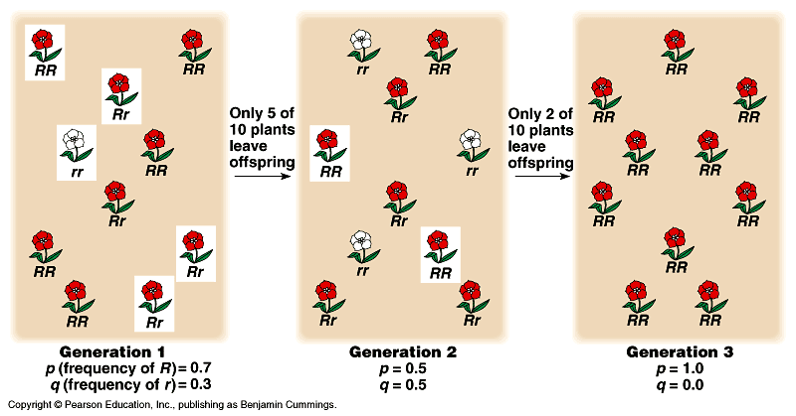
Genetic Drift

Slide 39
Genetic Drift

Slide 40
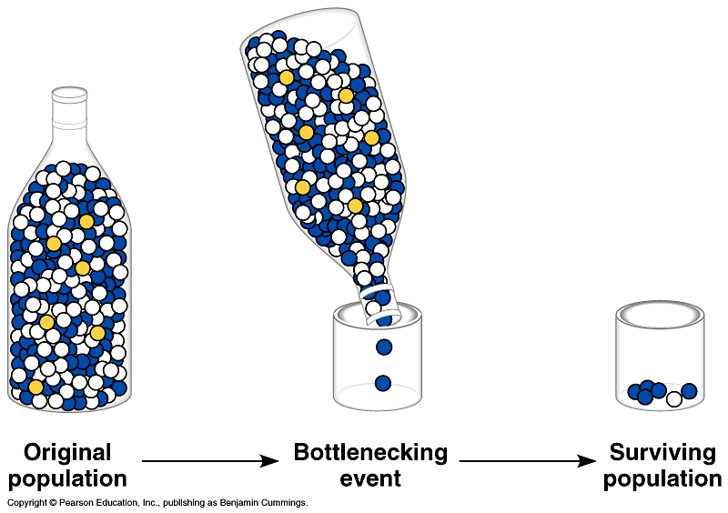
How Genetic Drift Can Affect a Population
Notes:
Natural disasters may reduce size of population
Reduces size of gene pool
By chance certain alleles may be under represented or eliminated
Reduces overall genetic variability in a population
Example–Northern elephant seals
reduced to 20 individuals by hunters in 1890's
increased since then to 30,000 under protection
No variation in 24 loci examined from present population
Example–South African cheetahs
large population severely reduced during last ice age and hunting pressures

Slide 41
Mutations
New mutations transmitted in gametes immediately changes gene pool of population by substituting one allele for another
Little quantitative effect on large populations in a single generation
  mutation at any given locus is rare
  allele with p=.5 that mutates to another allele at rate of 10⁻⁵ mutations per generation
    take 200 generations to reduce frequency of original allele to p=.49

Slide 42
Nonrandom Mating
Increases number of homozygous loci in population
Does not itself alter frequencies of alleles in gene pool
Two types:
  Inbreeding
  Assortative Mating

Slide 43
Nonrandom Mating--Inbreeding
Individuals of population mate with close neighbors rather than more distant members
Neighboring individuals of large populations tend to be closely related
Example
  self pollination in plants
  Selfing of AA & aa plants produce only homozygous plants
  Selfing of Aa produce ½ homozygotes and ½ heterozygotes
p & q don’t change
  only relative proportions of genotypes change

Slide 44
Natural Selection
NS is differential success in reproduction
Alleles are passed on to next generation in disproportionate numbers relative to frequencies in present generation
Only agent of microevolution that is adaptive
Only process that accumulates & maintains favorable genotypes
Environmental change results in selection favoring genotypes present in population that can survive new conditions
Variability in population makes it possible for NS to occur

